Slide 1

Deloitte Pre Hire Training
2017
FOUNDATION TRAINING
Spring Core

Slide 2
Spring Core
Spring 3.0 Introduction

Slide 3
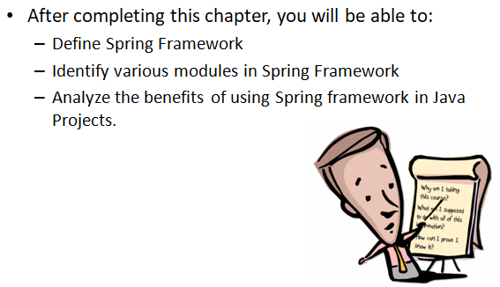
Objectives

Slide 4
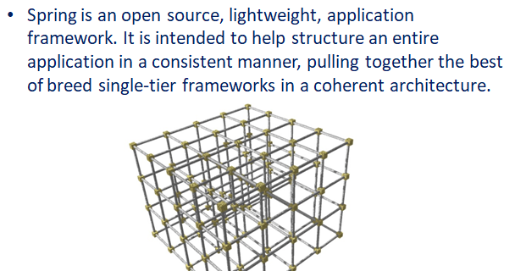
Spring Application Framework

Slide 5
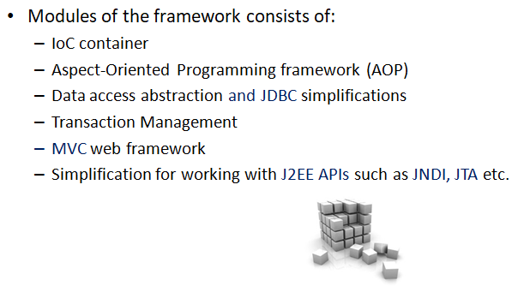
Module Components

Slide 6
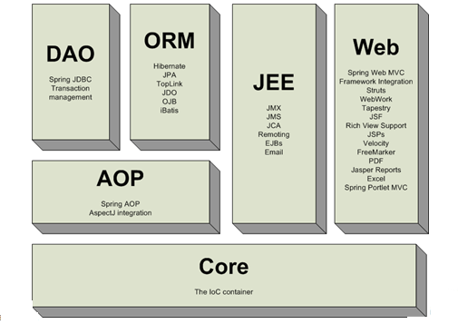
Spring Framework Modules

Slide 7
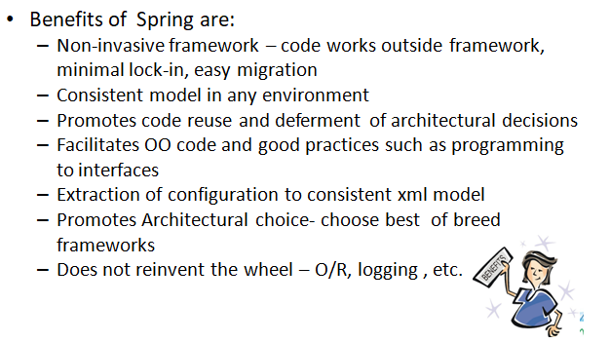
Spring Benefit

Slide 8
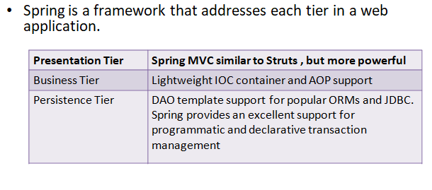
Spring Benefit

Slide 9
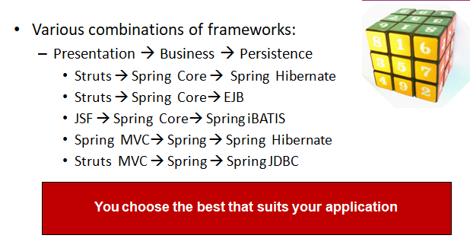
Application Layering Combination

Slide 10
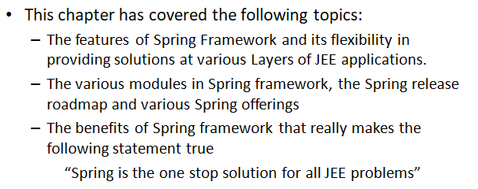
Summary

